Slide 1
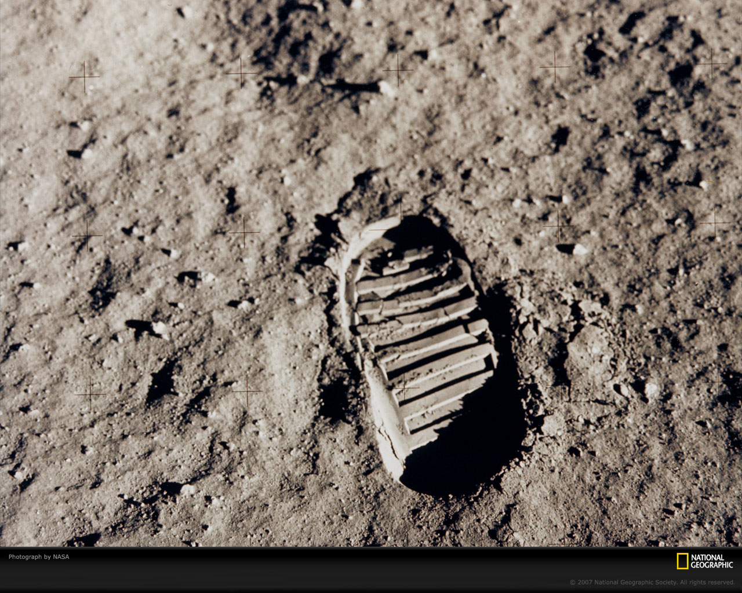
Astro- Quiz

Slide 2
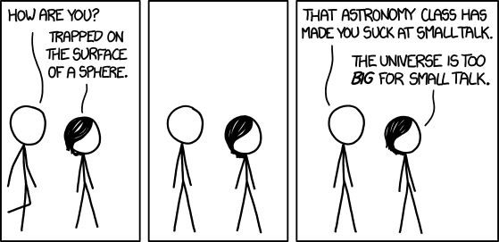

Slide 3
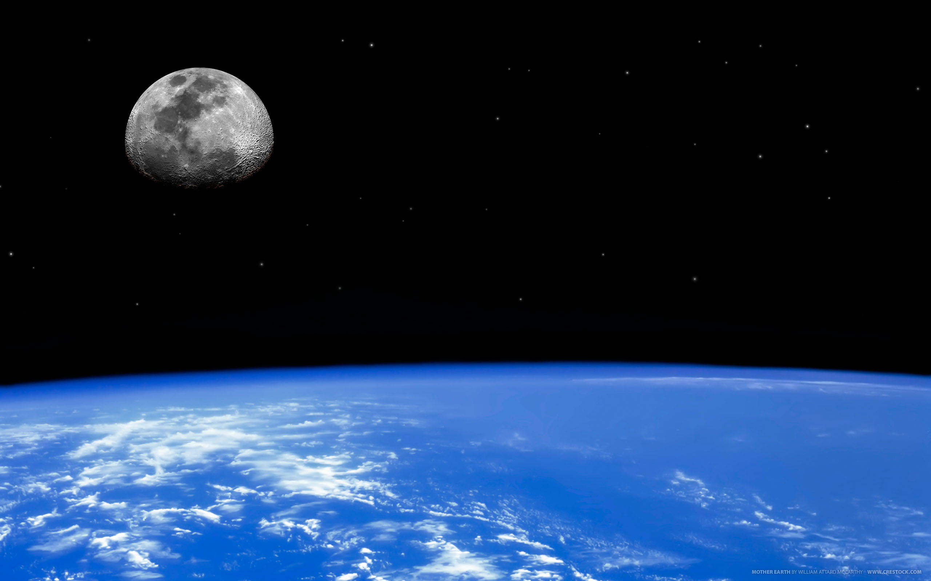
Sci-fi Planets
Notes:
Written round

Slide 4
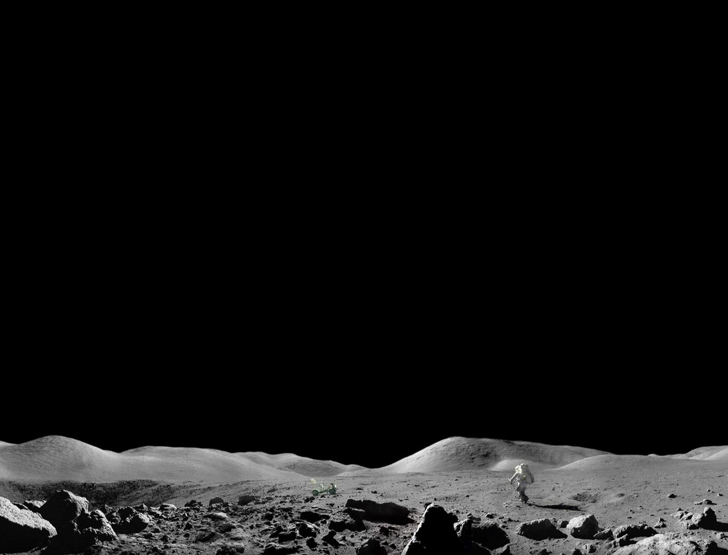
Question 1
Homeworld of a species of giant bugs, and launching point of their attack on Buenos Aires

Slide 5
Question 2
A pre-industrial society where human beings are kept as mute slaves.

Slide 6
Question 3
Site of a colony where poor radiation shielding has made mutants out of colonists, and some other things you may not remember.

Slide 7
Question 4
A planet of people who design and build other planets, and a computer to answer the ultimate question.

Slide 8
Question 5
A remote world covered in ice, used as a hidden base by an army of rebels.

Slide 9
Question 6
A lush jungle of exotic creatures, who all share a neural network. It is the best place to find Unobtanium.

Slide 10
Question 7
A hostile planetoid, home to a derelict spaceship full of eggs. Unsuccessfully colonized in the sequel.

Slide 11
Answer
Homeworld of a species of giant bugs, and launching point of their attack on Buenos Aires
A pre-industrial society where human beings are kept as mute slaves.
Site of a colony where poor radiation shielding has made mutants out of colonists, and some other things you may not remember.
A planet of people who design and build other planets, and a computer to answer the ultimate question.
A remote world covered in ice, used as a hidden base by an army of rebels.
A lush jungle of exotic creatures, who all share a neural network. It is the best place to find Unobtanium.
A hostile planetoid, home to a derelict spaceship full of eggs. Unsuccessfully colonized in the sequel.
Starship Troopers, Klendathu
Planet of the Apes, Earth
Total Recall,Mars
The Hitchhikers Guide to the Galaxy, Magrathea
Star Wars: The Empire Strikes Back ,Hoth
Avatar,Pandora
Alien, LV-426

Slide 12
Hint or No-Hint.
You choose.
Notes:
ID the pic. You get a bonus.

Slide 13
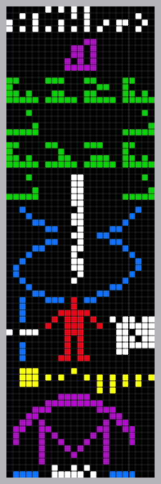
Question 1

Slide 14
Its an event that marked the remodeling of worlds largest single aperture telescope, Arecibo Observatory.
What is the event?

Slide 15
Answer
The Arecibo message was broadcast into space a single time via frequency modulated radio waves at a ceremony to mark the remodelling of the Arecibo radio telescope in Puerto Rico on 16 November 1974. It was aimed at the globular star cluster M13 some 25,000 light years away because M13 was a large and close collection of stars that was available in the sky at the time and place of the ceremony

Slide 16
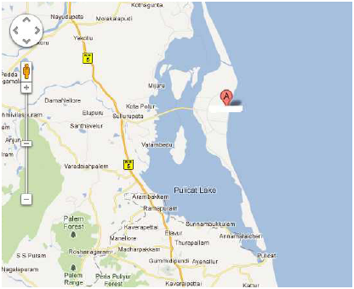
Question 2

Slide 17
It is a barrier island that separates the Pulicat Lake from the Bay of Bengal, and is home to the town of Pulicat.
The nearest town is Sullurpeta, which has the nearest railway station. It is 80 km (50 mi) from Chennai.
What is its claim to fame ? (see map)

Slide 18
Answer
Sriharikota
It houses India's only satellite launch centre in the Satish Dhawan Space Centre (SHAR) and is used by the Indian Space Research Organisation ISRO to launch satellites using multi-stage rockets such as the Polar Satellite Launch Vehicle (PSLV) and the Geosynchronous Satellite Launch Vehicle (GSLV)

Slide 19
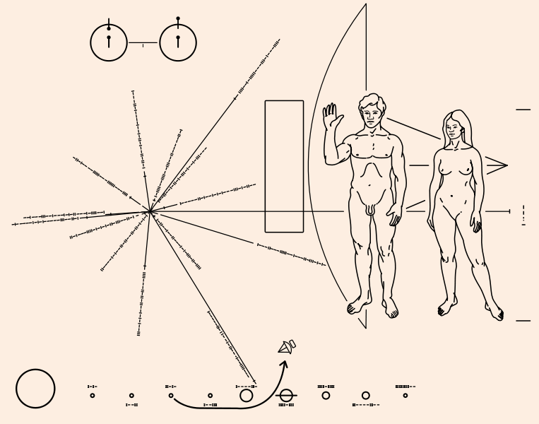
Question 3

Slide 20
The image is of a gold-anodized aluminium plaques which were placed on board the X spacecraft, featuring a pictorial message, in case X was intercepted by extraterrestrial life.
Id X.

Slide 21
Answer
Pioneer Plaques
Pioneer 1 and Pioneer 2

Slide 22
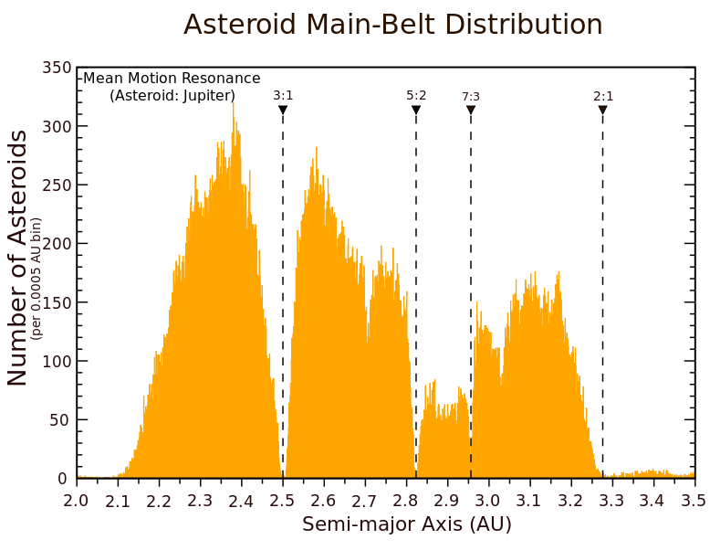
Question 4

Slide 23
The American Kepler
What are these gaps or dips in the distribution of main-belt asteroids by semi-major axis called as ? They correspond to the location of orbital resonances with Jupiter.
?

Slide 24
Answer
Kirkwood gap

Slide 25
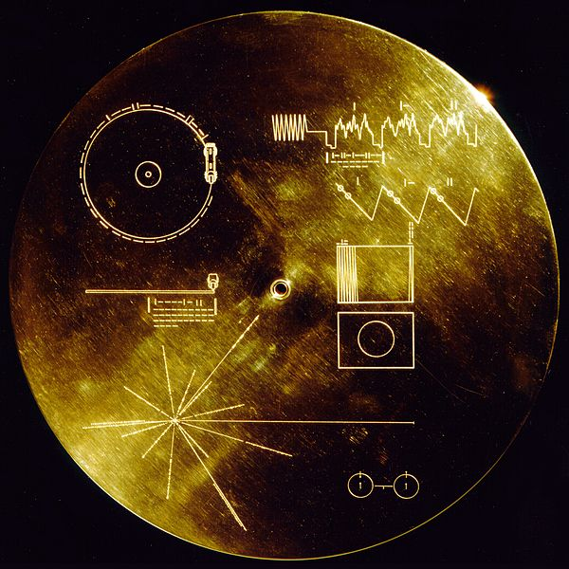
Question 5

Slide 26
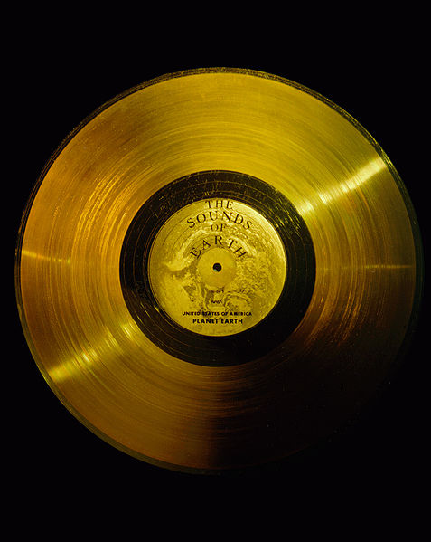
Poor Beatles
The two Voyager spacecraft each carry a record with the sights and sounds of Earth. What rock-and-roll song was included on it, thanks to the efforts of science writer Timothy Ferris? Give the title and artist

Slide 27
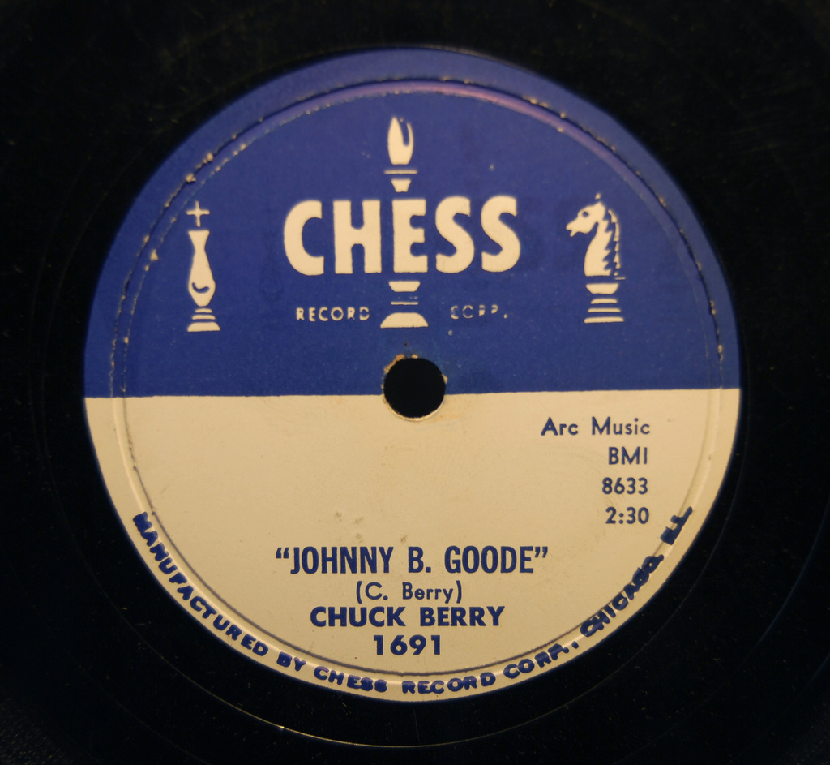
Answer
Notes:
There was a suggestion to include “Here comes the sun” from Beatles album Abbey Road, but that didn’t work out.

Slide 28
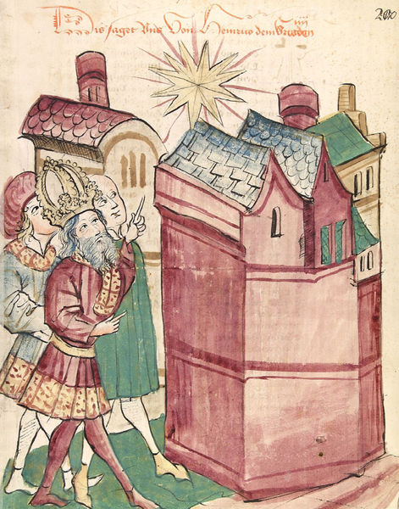
Question 6

Slide 29
Question 18
I’M 1
Its supernova that was first observed on 4 July 1054 (1054, significant?), and that lasted for a period of around two years.
Why is this Supernova famous?

Slide 30
Answer
Crab Nebula

Slide 31
Question 17
Connect the answers of Question 1, 3 and 5
The Person?

Slide 32
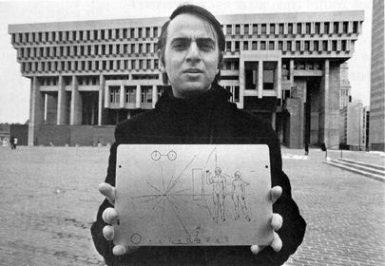
Answer
Carl Sagan

Slide 33
Mythology

Slide 34
Question
X is the Greek goddess of chaos, strife and discord, who initiated the Trojan War. The goddesses Hera, Athena and Aphrodite had been invited along with the rest of Olympus to the forced wedding of Peleus and Thetis, who would become the parents of Achilles, but X had been snubbed because of her troublemaking inclinations. She therefore tossed into the party the Apple of Discord, a golden apple inscribed τῇ καλλίστῃ – "For the most beautiful one", or "To the Fairest One" – provoking the goddesses to begin quarrelling about the appropriate recipient. The hapless Paris, Prince of Troy, was appointed to select the fairest by Zeus. The goddesses stripped naked to try to win Paris' decision, and also attempted to bribe him. Hera offered political power; Athena promised skill in battle; and Aphrodite tempted him with the most beautiful woman in the world: Helen, wife of Menelaus of Sparta. Paris chose to award the apple to Aphrodite, thereby dooming his city, which was destroyed in the war that ensued.
More recently, X and her daughter Y (lawlessness) have caused another war. ID X and Y.

Slide 35
Answer
X - Eris
Y – Dysnomia
Eris - previously called variously 2013UB313, Planet X or Xena (incidentally played by Lucy Lawless)

Slide 36
Question
A young farmer named Mikeran discovered on his farm a robe which, unbeknownst to him, belonged to a goddess named Tanabata. Soon after, Tanabata visited Mikeran and asked if he had found it. He lied and told the goddess that he hadn't but would help with her search. Eventually the pair fell in love, were wed and had many children. However, one day Tanabata noticed a piece of cloth which had once belonged to her robe on the roof of Mikeran's hut. His lie discovered, Tanabata agreed to forgive him on the condition that he weave a thousand pairs of straw shoes and bury them under the bamboo tree, but until that time, she would leave him. Mikeran wove the sandals and buried them under the bamboo tree as Tanabata had asked. When the tree grew, Mikeran climbed up to find that he was one step short. In his haste, he had used one sandal fewer than necessary, causing the tree to grow one step short. Mikeran called out to Tanabata and she came and lifted him up. Mikeran's father wasn't pleased so he gave Mikeran the difficult job of watching a melon field for three days and nights without touching a single melon. Mikeran however grew very thirsty watching the melons that he touched one. What did this result in?

Slide 37
Answer
Formation of the Milky Way

Slide 38
Question
Valacirca, the ______ of the Valar, Burning Briar, Durin’s Crown, Edegil, Otselen, Timbridhil — An important constellation set in the sky by Varda as an enduring warning to Melkor and his servants, and which precipitated the Awakening of the Elves. It also formed the symbol of Durin, seen on the doors of Moria, and inspired a song of defiance from Beren. According to the Silmarillion it was set in the Northern Sky as a sign of doom for Melkor and a sign of hope for the Elves. The Valacirca is one of the few constellations named in the book, another significant one being Menelmacar.
How do we know it (Valacirca) better?

Slide 39
Answer
Big Dipper/ Ursa Major

Slide 40
Question
______
Skathi
Skoll
Greip
Hyrrokkin
Jarnsaxa
Mundilfari
Narvi
Bergelmir
Suttungr
Hati.
Bestla
Farbauti
Thrymr
Aegir
Kari
Fenrir
Surtur
Ymir
Loge
Fornjot
Exhaustive list. Fill in the blanks

Slide 41
Answer
Phoebe. Only Greek name in Saturn's Norse group of satellites (named)

Slide 42
Question
Phaeton is a hypothetical planet posited to once have existed.
It was named for Phaeton, the son of the sun god Helios and Clymene in Greek mythology, who attempted to drive his father's solar chariot for a day with disastrous results and was ultimately destroyed by Zeus using a thunderbolt.
Inspired by this legend, where can we see this hypothetical heavenly body today?

Slide 43
Answer
Asteroids
It was supposed to exist between the orbits of Mars and Jupiter whose destruction supposedly led to the formation of the asteroid belt.
Theories regarding the formation of the asteroid belt from the destruction of a hypothetical planet are today collectively referred to as the "disruption theory" which states that there was once a major planetary member of the solar system circulating in the present gap between Mars and Jupiter, which was variously destroyed when:
it veered too close to Jupiter and was torn apart by the gas giant's powerful gravity.
it was struck by another large celestial body.
it was destroyed by a hypothetical brown dwarf, the companion star to the Sun known as Nemesis.
it was shattered by some internal catastrophe.
Today, the Phaeton hypothesis has been superseded by the accretion model.

Slide 44
Question
The name X derives from Arabic: ra‘s al-ghūl. The English name “Demon Star” is a direct translation of this. In Hebrew folklore, X was called Rōsh ha Sāṭān or “Satan’s Head”, as stated by Edmund Chilmead, who called it “Divels head” or Rosch hassatan. A Latin name for X from the 16th century was Caput Larvae or “the Spectre‘s Head”. X was also linked with “Lilith”. Hipparchus and Pliny made this a separate, though connected, constellation. In Chineese, according to R.H. Allen the star bore the grim name of Tseih She (Dié Shī), meaning "Piled up Corpses” but this appears to be a misidentification.
Historically, the star has received a strong association with bloody violence across a wide variety of cultures. In the Tetrabiblos, the 2nd-century astrological text of the Alexandrian astronomer Ptolemy, X is referred to as "the Gorgon of _____" and associated with death by decapitation. Unsurprisingly, astrologically it is considered one of the unluckiest stars in the sky, and was listed as one of the 15 Behenian stars.

Slide 45
Answer
Algol

Slide 46
Real-world Astronomy

Slide 47

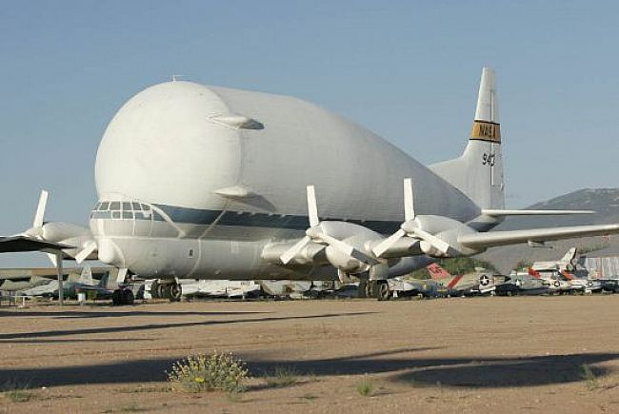

Question 2
What are these bloated spacecrafts famously called as?
(available in 3 different sizes)
1
3
2
Notes:
Develpoed specially for NASA
The size

Slide 48
Answer
Aero Spacelines, Inc. was a United States aircraft manufacturer which made a name for itself by converting Boeing 377 Stratocruisers into the famous Guppy line of airplanes, re-engineered solely for transporting oversized cargo such as space exploration vehicles.
Mini Guppy
Pregnant Guppy
Super Guppy
1
3
2

Slide 49
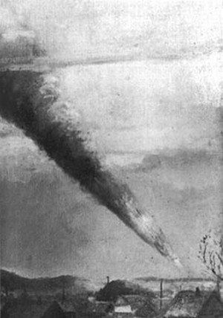
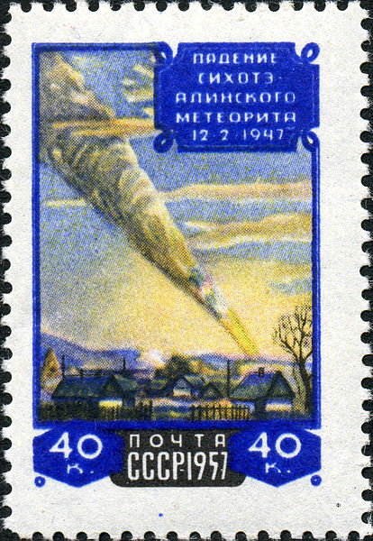
Question 3
Painting
X is an iron meteorite that fell on 12 February 1947 in the mountains of Siberia.
X is named after the same mountain range
A smoke trail, estimated at 32 km (20 mi) long, remained in the sky for several hours.
On November 20, 1957 the Soviet Union issued a stamp for the 10th anniversary of this meteorite shower. It reproduces a painting by P. J. Medvedev, a Soviet artist who witnessed the fall.
Stamp

Slide 50
Answer
Sikhote-Alin

Slide 51
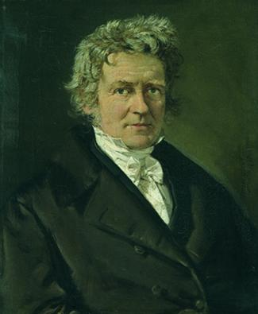
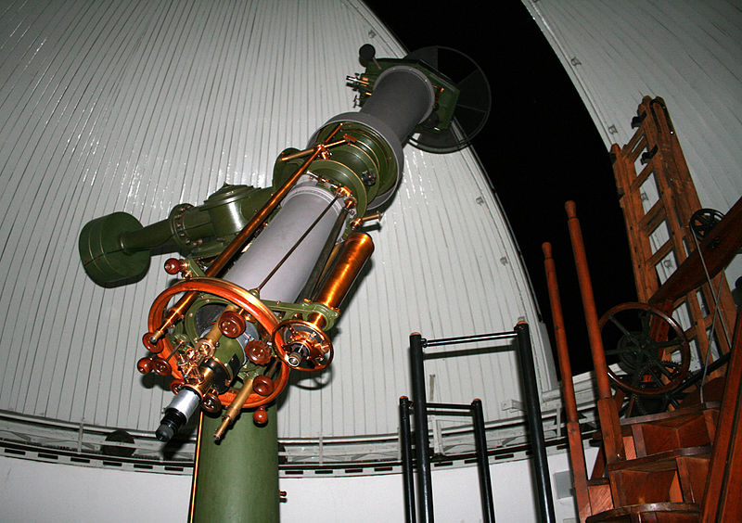
Question 22
Piazzi’s Flying Star
Heliometer
Friedrich Wilhelm Bessel

Slide 52
Answer
The first successful measurements of stellar parallax (to determine the distance to a star) were made by Friedrich Bessel in 1838 for the star 61 Cygni (also called as Bessel Star and Piazzi’s Flying Star) using a Fraunhofer heliometer

Slide 53
Question 23
The name X of an automobile manufacturer stands for the Pleiades (Common name? Messier?) star cluster. This in turn inspired its logo. X launched an animation series Hōkago no Pleiades (lit. 'After School Pleiades') developed jointly with Gainax. The 4-part mini episode series was released on YouTube on February 1, 2011. It featured a magical girl plot with the character X as a leading protagonist.

Slide 54
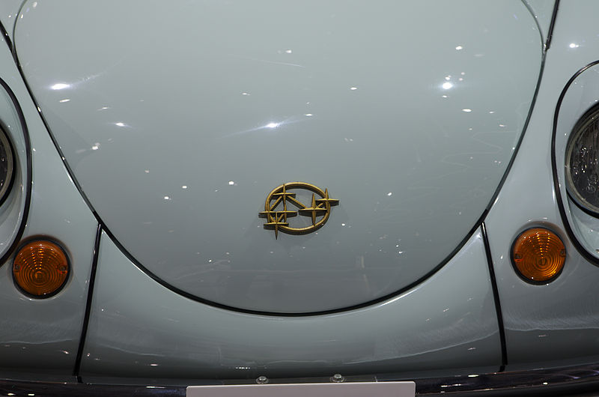
Answer
Subaru

Slide 55
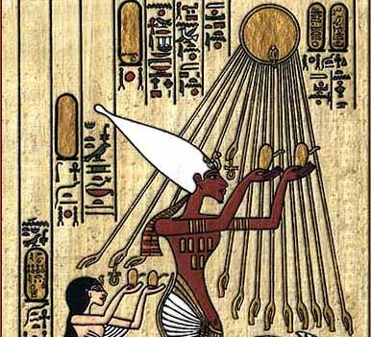
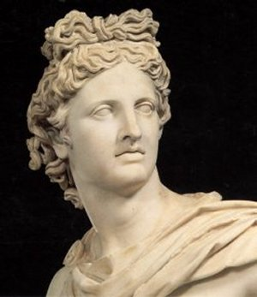
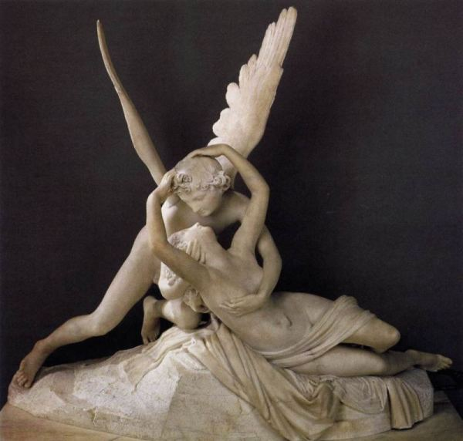
Question 3
Notes:
Apollo? Trojans?

Slide 56
Answer
Near Earth Asteroids

Slide 57
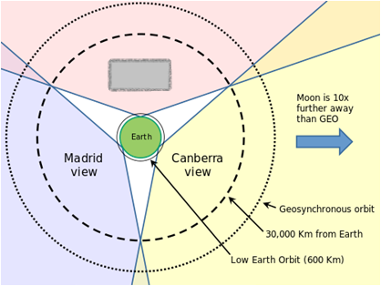
Question 5
X is a gold-mining ghost town in California
X hosts one of the three deep-space communication facilities of NASA’s Deep Space Network
It is commonly believed that the first U.S. satellite, Explorer I, was confirmed to be in orbit by the use of the phrase “X has the bird“. However the facility was not in operation at the time of Explorer I, and like many oft-repeated quotations it is incorrect.

Slide 58
Answer
Goldstone

Slide 59
Connect

Slide 60
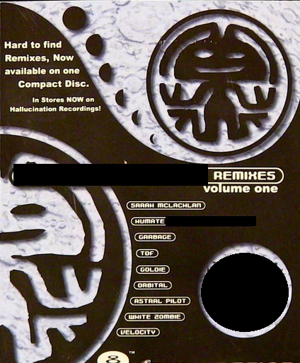
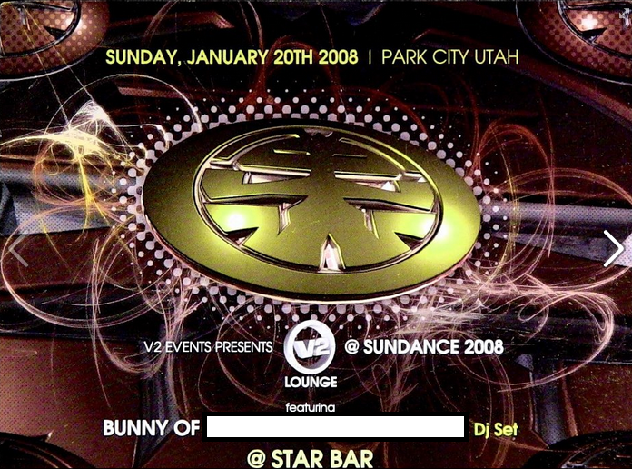


Slide 61
Video

Slide 62
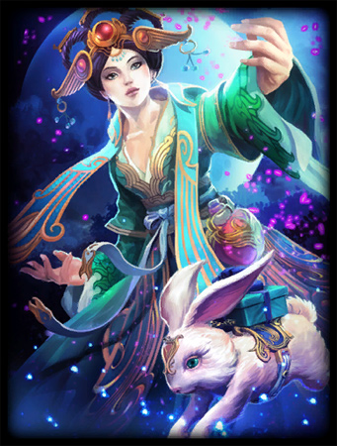


Slide 63
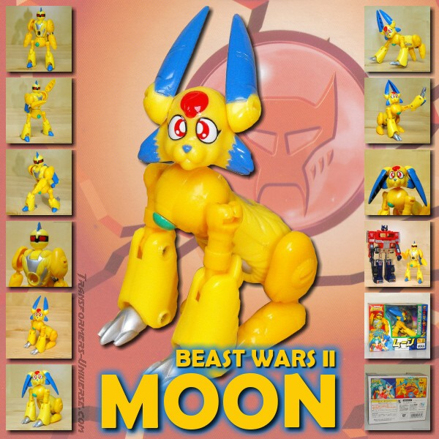

Slide 64
Answer
(Next Slide)

Slide 65


Slide 66
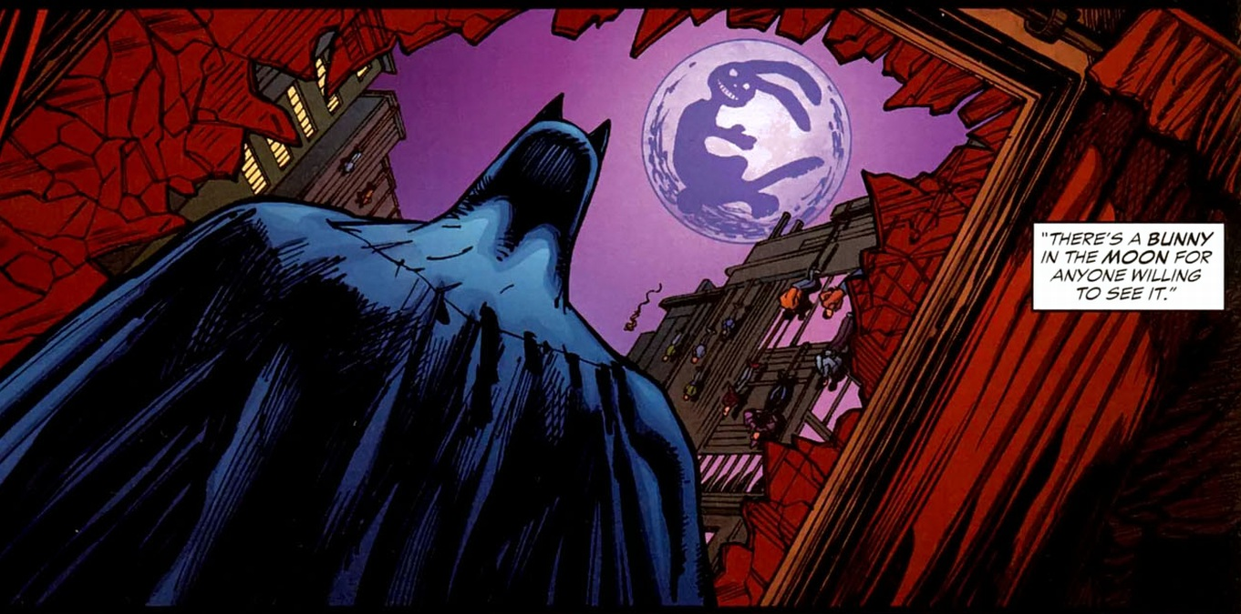

Slide 67
Answer
The American electronic music group Rabbit in the Moon
The 1998-1999 Japanese-exclusive Transformers animated series Beast Wars II features Moon, a robotic rabbit who lives in the moon with Artemis.
In the Dragon Ball episode "Boss Rabbit's Magic Touch”, Goku exiles Monster Carrot and his henchmen to the moon, where they are shown pounding on rice cakes.
Chang'e and the Jade Rabbit/Moon Rabbit are featured as playable characters in the video game Smite, although the player does not assume direct control of the Jade Rabbit.
Batman comic : Batman Confidential #12 , Lovers and Madmen

Slide 68
Some Astronomers Some Astronomy

Slide 69
Question 24
X : Among the large headlines concerning Apollo this morning, there's one asking that you watch for a lovely girl with a big rabbit. An ancient legend says a beautiful Chinese girl called Chang-o has been living there for 4000 years. It seems she was banished to the Moon because she stole the pill of immortality from her husband. You might also look for her companion, a large Chinese rabbit, who is easy to spot since he is always standing on his hind feet in the shade of a cinnamon tree. The name of the rabbit is not reported.
Y: Okay. We'll keep a close eye out for the bunny girl.
Id X and Y

Slide 70
Answer
X - Houston
Y - Edwin "Buzz" Aldrin

Slide 71
Question 21
X was an American astrophysicist who, with William A. Fowler, won the 1983 Nobel Prize for Physics for key discoveries that led to the currently accepted theory on the later evolutionary stages of massive stars.
Y also won the Nobel Prize for Physics
Y was elected a Fellow of the Royal Society early in his career (1924) and knighted in 1929.
In 1941 he was awarded the Franklin Medal. He was also awarded the Lenin Peace Prize in 1957.
X was the nephew of Y.
X and Y?

Slide 72
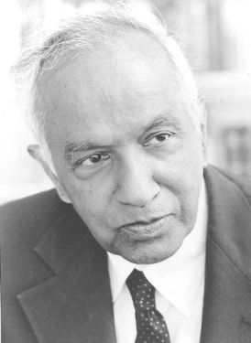
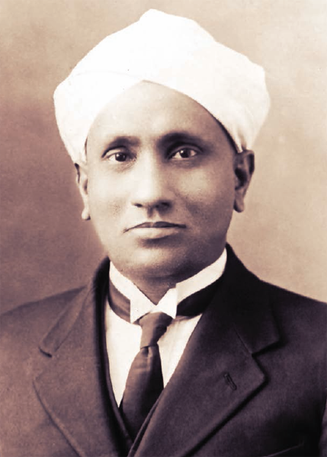
Answer
X - Subrahmanyan Chandrasekhar
Y - C. V. Raman

Slide 73
Question 7.
Garage
X is a rock song from the band Y.
The song's lyrics are selected verses from a poem by Sandy Pearlman, the band's producer and mastermind behind their image, called "The Soft Doctrines of Immaginos".
Longtime Y fan and author Stephen King recorded a spoken narration for the video, which is as follows:
"Imaginos - A bedtime story for the children of the damned. From a dream world, paralleling our earth in time and space, the invisible ones have sent an agent who will dream the dream of history. With limitless power he becomes the greatest actor of the 19th century. Taking on many ingenious disguises, he places himself at pivotal junctures in history, continually altering its course and testing our ability to respond to the challenge of evil. His name is 'Imaginos'“.
In X, the character of Imaginos comes to realize his heritage and his role as the altered human. References are made to celestial objects throughout the song: "The light that never warms" being the moon, "The Queenly flux" the constellation Cassiopeia, "My dog, fixed and consequent" being Sirius, the dog star. The "Four Winds Bar" may be a reference to the Tropic of Cancer. All in all, it has Imaginos explaining his position as part of Les Invisibles.
Id X and Y

Slide 74
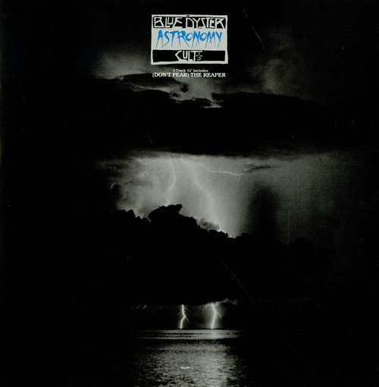
Answer
X – Astronomy
Y – Blue Oyster Cult
Notes:
Garage Inc. Metallica did a cover for this song

Slide 75
Question 8
T -10, T – 9, T – 8, … T - 0
During spring of 1982, the band X watched the launching of the Columbia Space Shuttle from Cape Kennedy, Florida.
Y is a X’s song that describes the launch of STS-1 and the Space Shuttle Columbia
The song was used as a wakeup song for astronauts during STS-109, which was the last successful flight of Space Shuttle Columbia. It was used again for astronaut Mike Fincke during STS-134, flown by Space Shuttle Endeavour on its final mission before retirement

Slide 76
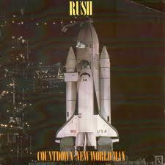
Answer
Song - Countdown
Band - Rush

Slide 77
Question 10
This is Pure Reasoning
Thomas Wright, an English astronomer published “An original theory or new hypothesis of the Universe” in 1750. In it, he put forward the idea that the Milky Way is “an optical effect due to our immersion in what locally approximates to a flat layer of stars.”
In 1755, X expanded on Wright’s ideas, theorizing that the Milky Way was a disc made up of stars, formed from a cloud of gas, which was spinning. He was the first to suggest that other nebulae which had been observed could also be discs of stars, thus opening a whole new idea of astronomy beyond our solar system.
X introduced the term "island Universe" for these distant nebulae.
“Island Universe” – The idea that our Sun is just one of myriads of stars in a huge stellar system, the Milky Way, and that there may be many other stellar systems of equal rank outside the Milky Way

Slide 78
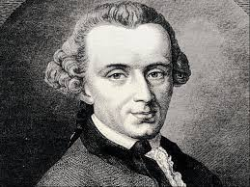
Answer
Immanuel Kant

Slide 79
Question 11
In 1995, Nancy Lieder, put forward an idea about disastrous encounter between the Earth and a large planetary object named Y.
She founded the website ZetaTalk.
She describes herself as a Contactee with the ability to receive messages from extra-terrestrials from the Zeta Reticuli star system through an implant in her brain.
Although Lieder originally referred to the object as "Planet X", it has become deeply associated with Y, a planet from the works of ancient astronaut proponent Zecharia Sitchin, particularly his book The 12th Planet.

Slide 80
Answer
Nibru

Slide 81
Lists

Slide 82
Question 12
A, a Germnan Astronmer , was first person to view the planet Neptune and know what he was looking at. He used the calculations of B to know where to look.
A always refused to be acknowledged as the discoverer of Neptune; he attributed the discovery to B
B predicted the existence of the then unknown planet Neptune, using only mathematics and astronomical observations of the known planet Uranus.
Encouraged by physicist Arago, B was intensely engaged for months in complex calculations to explain small but systematic discrepancies between Uranus's observed orbit and the one predicted from the laws of gravity of Newton. In François Arago's apt phrase, B had discovered a planet "with the point of his pen".
At the same time, but unknown to B, similar calculations were made by C in England.
The discovery of Neptune led to the discovery of its moon Triton by William Lassell just seventeen days later. William Lassell is also credited for the discovery of Hyperion (a moon of Saturn), Ariel and Umbriel (two moons of Uranus).
The names A, B, C, Lassell and Arago form a exhaustive list. What is it?

Slide 83
Answer
Neptune Rings
Ring names | Properties
Galle | Brown faint ring
Le Verrier | Narrow Ring
Lassell | Lassell ring is a faint sheet of material stretching from Le Verrier to Arago
Arago
Adams | Five bright rings

Slide 84
Question 19
Get some extra credits
Edmond Halley (1656-1742) published a list of six "luminous spots or patches" in the Philosophical Transactions of the Royal Society for 1715
A (Messier?) – It’s a treat on winter nights. There has been speculation that the Mayans of Central America may have described A within their "Three Hearthstones" creation myth
B (Messier?)- Simon Marius observed it in 1612
'....like a flame of a candle seen through horn. ....whitish, irregular and faint; brighter toward the center.‘
M22 – Discovered in 1665 by Abraham Ihle, it is one of the brightest globular clusters
(Name ? Constellation ?) NGC 5139– Halley's own discovery 1677 Ptolemy catalogued this object in his Almagest as a star on the horse's back
(Name? Constellation ?) M11
(Constellation ?) M13 – Halley's own discovery 1677
Id A and B. Get bonus for names and constellations

Slide 85
Answer
Edmond Halley published a list of 6 "luminous spots or patches":
in Orion: The Orion Nebula M42
in Andromeda: The Andromeda Galaxy M31
in Hercules: Globular Cluster M13 (Halley's own discovery 1714)
in Sagittarius: Globular Cluster M22
in Antinous (Scutum): Wild Duck Cluster, Open Cluster M11
in Centaurus: Globular Cluster Omega Centauri (NGC 5139; Halley's own discovery 1677)

Slide 86
Question 20
One Short
Vega, Thuban, Alpha Cephei, Iota Cephei, Theta Bootis, Beta Ursae Minoris, Kappa Draconis, Gamma Cephei

Slide 87
Answer
North Pole Stars, Missing - Polaris

Slide 88
Question 13
All The Great Constellations Live Very Long Since Stars Can't Alter Physics.
As The Great Cook Likes Very Little Salt, She Compensates Adding Pepper.
Really Boring Teachers Can Live Very Sadly Since Apples Give Worthless Feelings.
All That Gold Can Load Very Lazy Students Since Children Are at Play
What am I talking about?

Slide 89
Answer
Zodiac Signs (first Letters)

Slide 90
Question 9
Zanya, Unity, Zveda, Destiny, Quest, Pirs, Harmony, Columbus, Kibo, Cupola, Rassvet, Leonardo, Nauka*, Uzolovoy*
Exhaustive list
I need the exact answer
What is the asterix for?

Slide 91
Answer
Pressurised modules, International Space Station
* - scheduled additional modules

Slide 92
Stamps

Slide 93
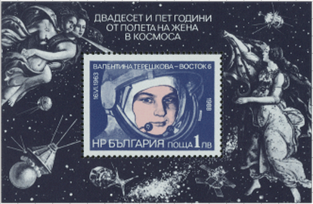
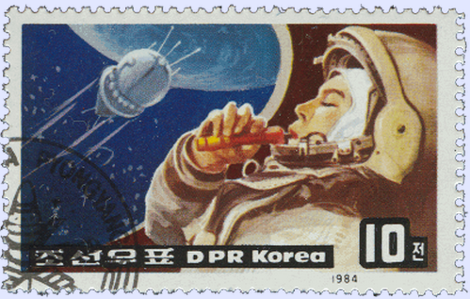

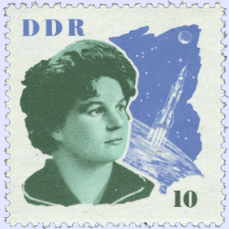
Question

Slide 94

Answer
Valentina Vladimirovna Tereshkova ( is a retired Soviet cosmonaut and engineer, and the first woman to have flown in space.

Slide 95
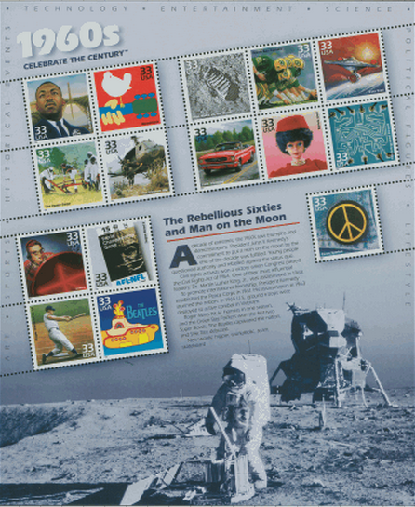
Question

Slide 96

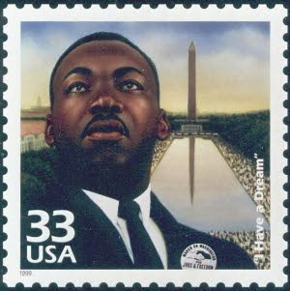
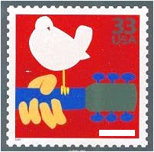

?

Slide 97
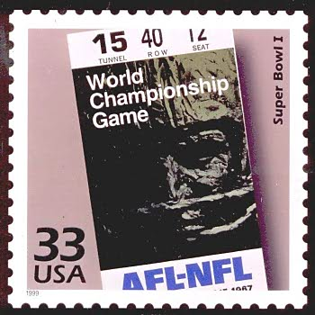
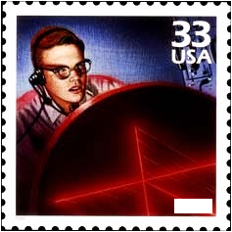

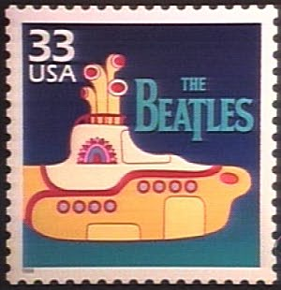
?

Slide 98
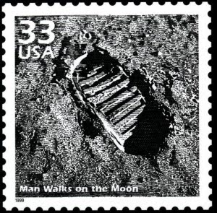
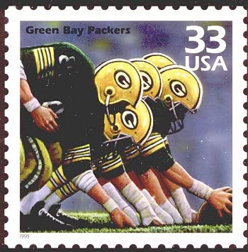
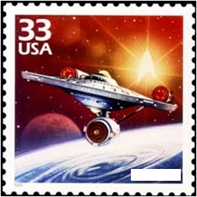
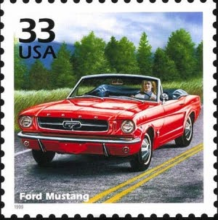

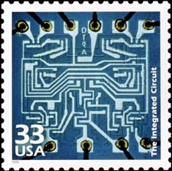
?

Slide 99
Answer
Woodstock
Laser
Star Trek

Slide 100
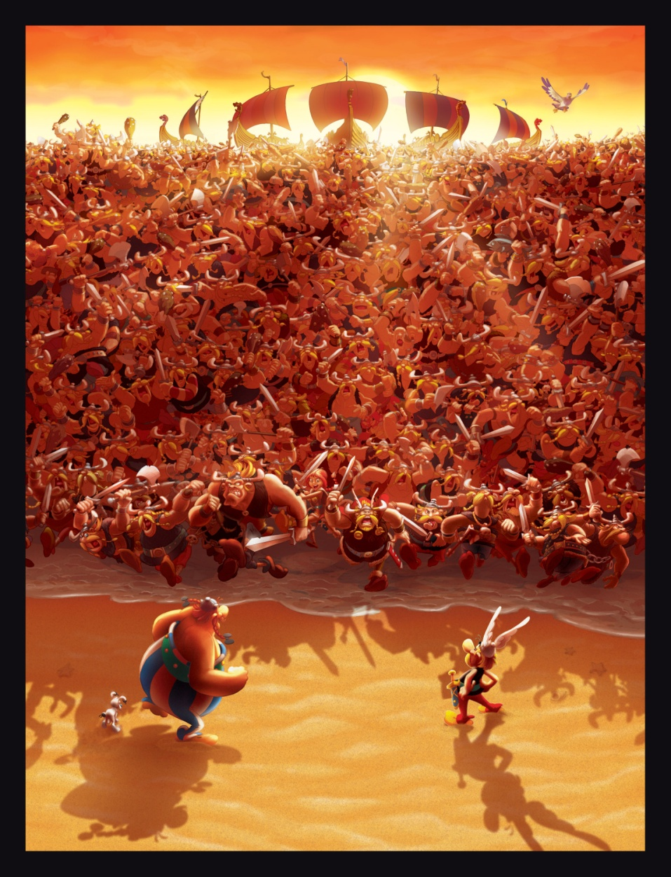
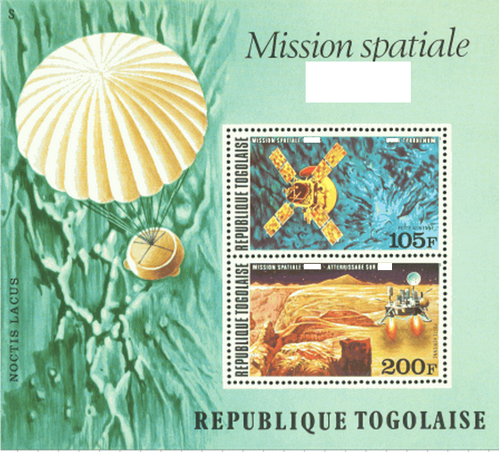
Question
In your face, Asterix!

Slide 101
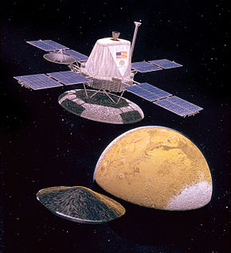
Answer
The Viking program launched Viking 1 and 2 spacecraft to Mars in 1975; The program consisted of two orbiters and two landers – these were the first two spacecraft to successfully land on Mars.

Slide 102


Question

Slide 103
Answer
International Space Station
Hubble Space Telescope

Slide 104





Question

Slide 105

Answer
Rocket mail is the delivery of mail by rocket or missile. The rocket would land by deploying an internal parachute upon arrival. It has been attempted by various organizations in many different countries, with varying levels of success. It has never become widely seen as being a viable option for delivering mail, due to the cost of the schemes and numerous failures.
The collection of philatelic material ("stamps") used for (and depicting) rocket mail is part of a specialist branch of aerophilately known as astrophilately
Stephen Hector Taylor-Smith often known as Stephen Smith, was a pioneering Indian rocket scientist who developed techniques in delivering mail by rocket.

Slide 106

Question

Slide 107


Answer

Slide 108

The Eagle has landed
The Quiz has ended

